Slide 1
Classless but Ebbinghaus-polite
Python Coding
Howard Schneider Sheppard Clinic North, Toronto, Canada
github.com/howard8888
PyCon Canada 2018

Slide 2


Anything that let’s me transform an idea into code is great

Slide 3
Python OOPs, …

Slide 4
This talk is not ‘against’ OOP….
In the Python textbook, OOP seems like a wonderful idea….
But, as I code and code my project, the logic behind OOP – for my project anyway– does not really hold up….

Slide 5
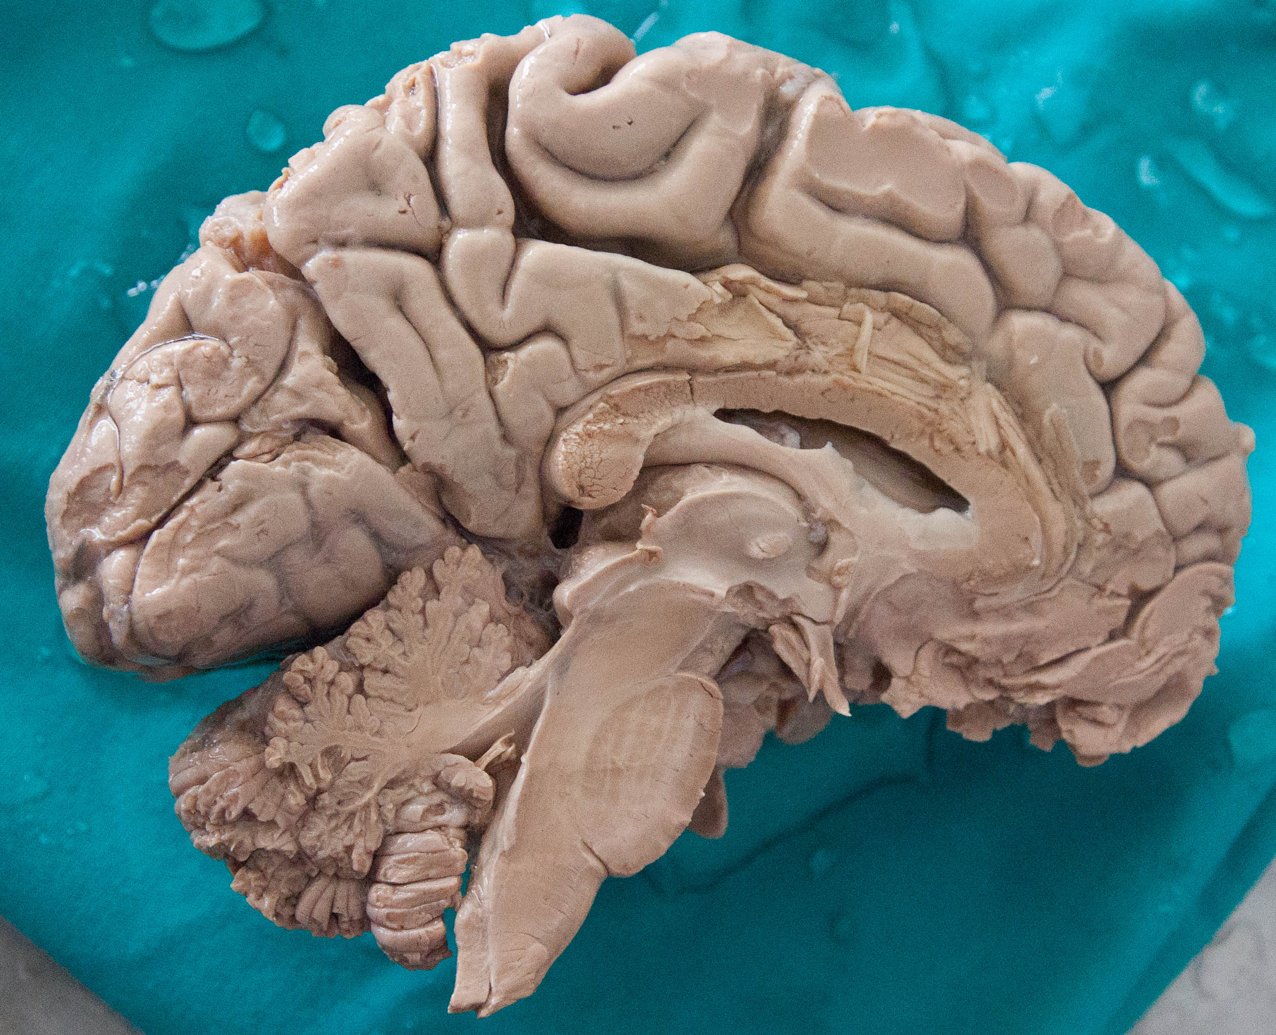
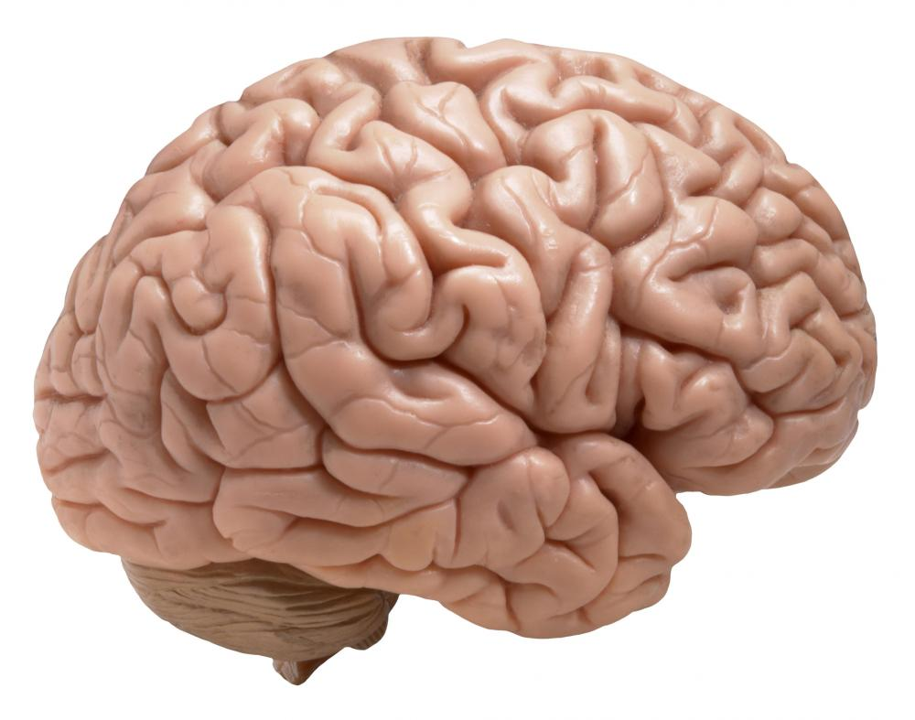
My Project: Simulation of a Biologically Inspired Cognitive Architecture

Slide 6


Large problem to solve – “Neural Symbolic Gap”
∙ Neural Network – phenomenal image processing and reinforcement learning
∙ Child – phenomenal causal learning with few examples (eg, Gopnik)

Slide 7
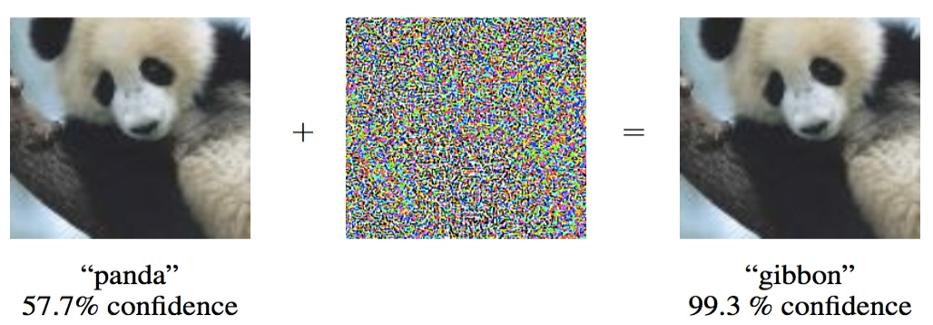

Goodfellow,I.J., Shlens,J. and Szegedy,C. (Google Mountainview), Explaining and Harnessing Adversial Examples, ICLR 2015.
It’s still a Panda – and the 3 year old boy would know this!! (and…. 3 year old only needs 1 or 2 photos for training, not 1000s)

Slide 8
Deep Learning Neural Network | 3 Year Old Human Child
Pattern Recognition →Recognize the World | Model Building +also Pattern Recognition →Explain the World
Need 1000’s examples for learning | A few examples enough

Slide 9
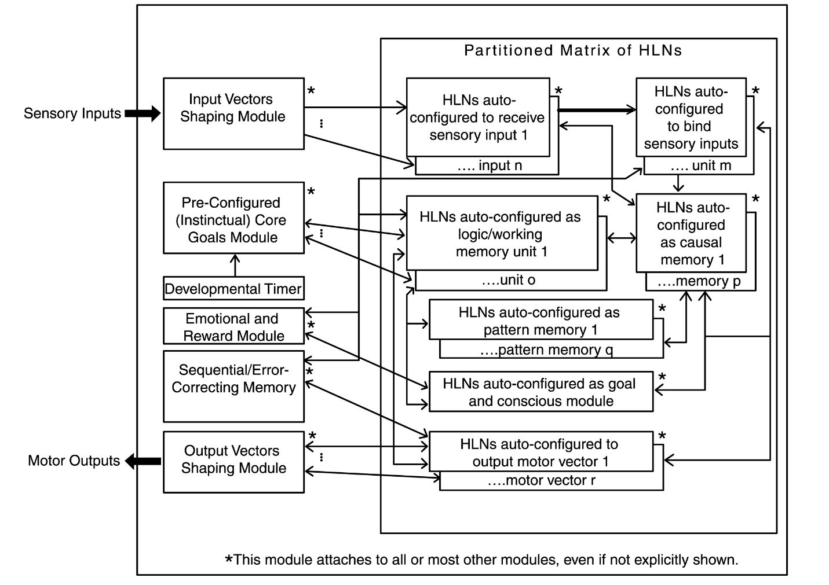
Cognitive Architecture to simulate….
MBLS (“Meaningful-Based Learning System) based on this “Meaningful-Based Cognitive Architecture”

Slide 10
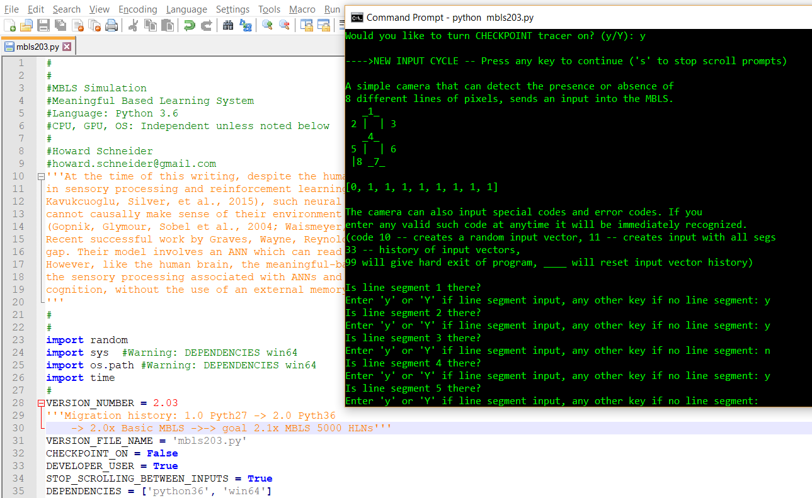
Build small MBLS simulation in Python….

Slide 11
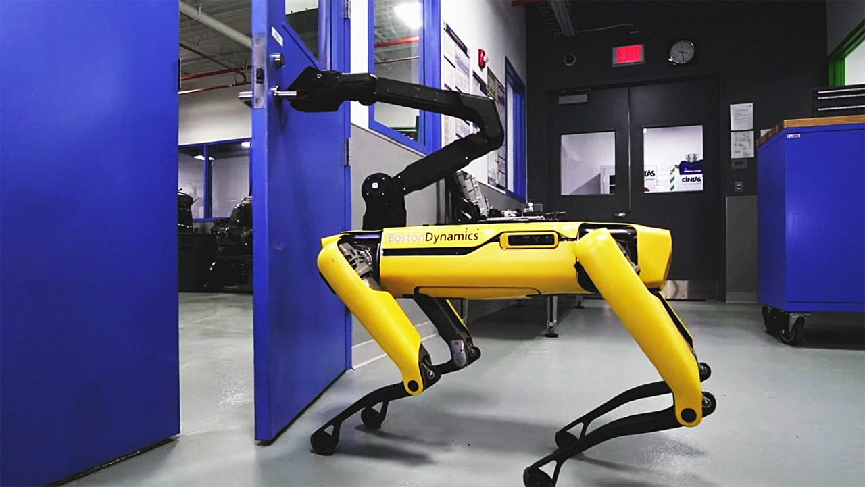
Attempt larger simulation in Python….
MBLS RESCUE
Controlled by an MBLS
(hypothetical!!)

Slide 12
Issue: Programmer does not have enough working memories in programmer’s human brain to do the Python coding of the simulated cognitive architectures….
Takes too long to learn, ie create memories in human brain, of the computer structures we create in the Python code….

Slide 13
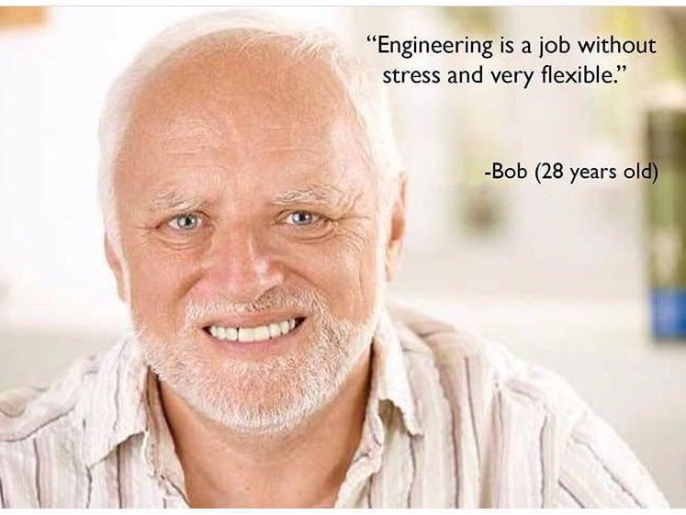
Too many names and classes and names and mess of hierarchies…. on and on…..

Slide 14
Point of this talk:
If a paradigm uses up very limited and very valuable human working memories:
Paradigm may be more disadvantageous than advantageous

Slide 15
Harder to construct a very large code in first place
Harder for person reading code to figure out what is going on
MUST take human ‘memory bandwidth’ into account

Slide 16
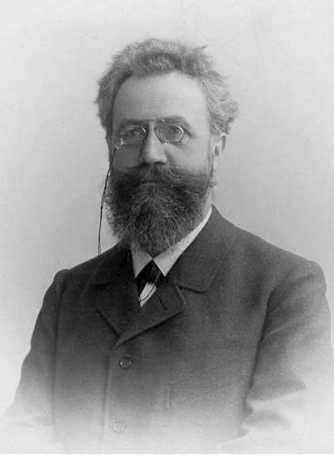
Hermann Ebbinghaus – learning curve (1885) -- memorizing series of nonsense syllables
–> Human memory has limits and characteristics

Slide 17
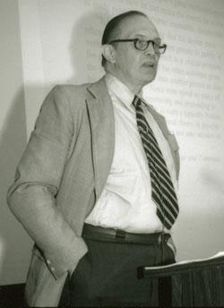
George Miller – (1956) – “The Magical Number Seven, Plus or Minus Two”
–> the number of objects an average human can hold in working memory is 7 ± 2

Slide 18
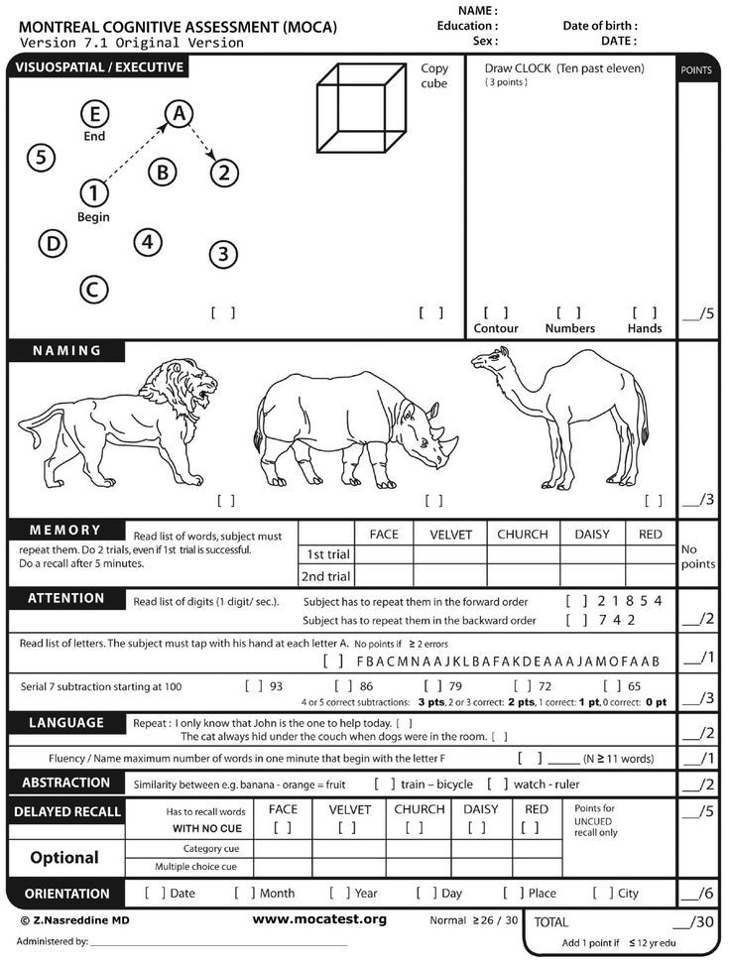
MOCA Test

Slide 19
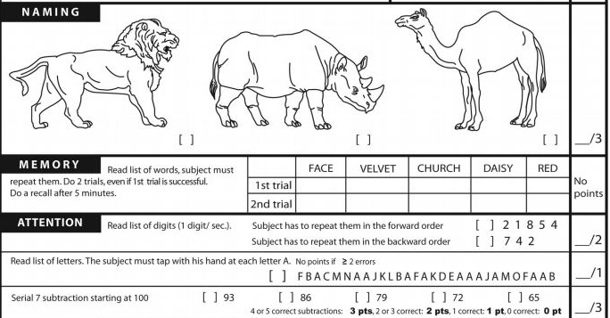
Humans have a tiny number of working memories

Slide 20
My simulation deals with hundreds of millions of cortical columns (‘HLNs’ in the simulation), not a fictional bookstore example in the OOPs chapter of a computer science textbook
Class structure offers very little advantage in creating my simulation but causes me to have to store in my limited brain memory a complex mess of rigid (aghh!!) inheritance hierarchies, class names,….
Eliminate!!

Slide 21
Replace OOP with ‘HOP’ (‘Human Oriented Programming’)
Must minimize anything that taxes the very limited human working memory (or else take months and months to memorize all the variables and cute coding blocks)
This also allows maintenance by humans with the same limited working memory.

Slide 22
Avoid short variable names but try to use names which allow the reader to follow what the variable represents
Use any sort of database, NOT inheritance, to code relationships (pure hierarchies are a myth in real world)
From point of view of human memory: W.E.T. (Wrote Everything Twice) – can be good D.R.Y. (Do Not Repeat Yourself) – can be bad

Slide 23
Ok to allow many and changing variables to participate in an action and share data as long as all is working-memory friendly
All functions must have built-in unit tests, reflecting weaknesses of human working-memory in evaluating code behavior, even in small decomposed functions
“Classless but Ebbinghaus-polite Python code”

Slide 24

“To date there have been 3 Programming Paradigms …. There are unlikely be any others….” -Robert C. Martin, “Clean Architecture”, 2018

Slide 25
Martin’s 3 Paradigms
Structured Programming (restrict direct transfer control)
Object-Oriented Programming (restrict indirect transfer control)
Functional Programming (restrict assignment) ---------------------------------
? Human Oriented Programming?
(restrict anything > working memories)

Slide 26
Where are the References??
Surprising thing is that despite use of OOP by millions of developers for decades, there is very little reproducible evidence in the literature that OOP is more effective than other paradigms.

Slide 27

“Classless but Ebbinghaus-polite Python coding”
(HOP not OOP)
github.com/howard8888
howard.schneider@gmail.com

